Slide 1
Hello Everybody,,,,, MD.Dulal Hossain ID :- 213902116

Slide 2
#include<stdio.h>

Slide 3
What is #include<stdio.h>
#include<stdio.h> is statement or it can also be called preprocessor command.

Slide 4
#include<stdio.h> Pre-processor Header File Directive

Slide 5
How #include<stdio.h> works ? Preprocessing Compiling Linking

Slide 6
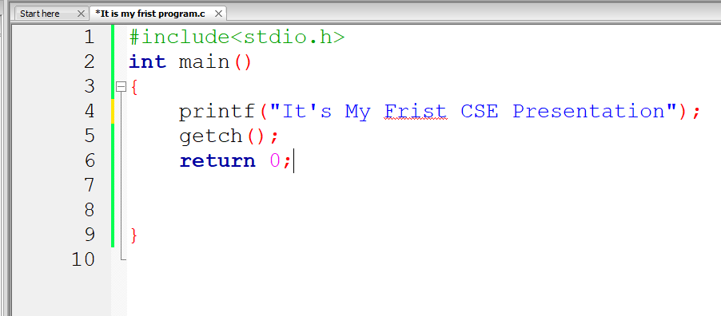
Source Code

Slide 7
Thank For Your Attention,,,,,

